Slide 1
TSI, Citrate, Urease, MR and Indole test

Slide 2
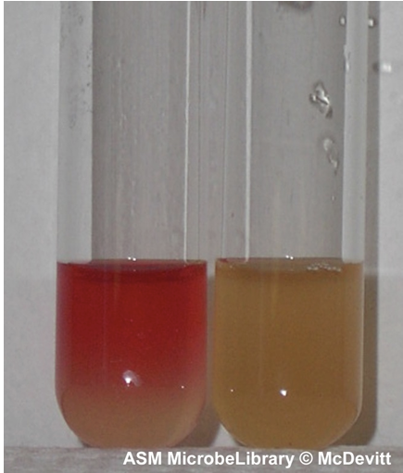
MR test
All organism that show a positive MR test look similar.
All organisms that show a negative test look similar
Source for the images
https://asm.org/getmedia/40946f85-9357-4563-aa8a-994427efa825/methyl-red-and-voges-proskauer-test-protocols.pdf
This test can use a diagram like you have been using: just a test tube with reddish orange (for positive) or mustard yellow liquid (for negative)
Positive on the left, negative on the right

Slide 3
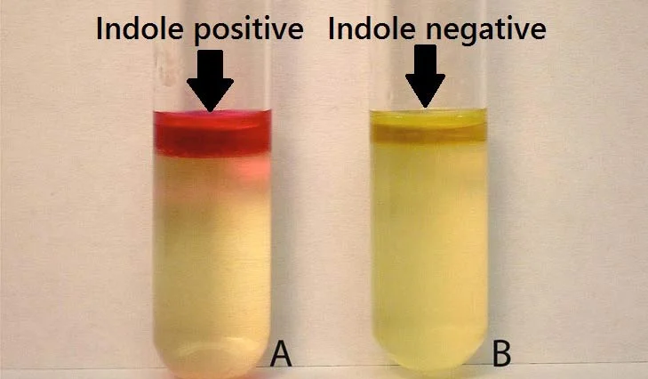
Indole test
All positive test look similar (red ring on top). All negative tests look similar ( a oily ring that is not red, reflects the yellow below
https://microbiologyinfo.com/indole-test-principle-reagents-procedure-result-interpretation-and-limitations/

Slide 4
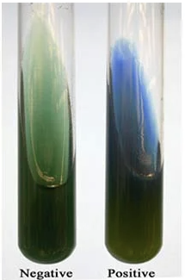
Citrate test
All citrate organism that show a positive test look similar.
All organisms that show a negative organisms look similar
Source for the images
https://microbiologyinfo.com/citrate-utilization-test-principle-media-procedure-and-result/

Slide 5
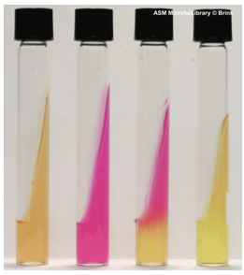
Urease test
All organism in our list that show a positive test look similar.
All organisms that show a negative organisms look similar
https://asm.org/getattachment/ac4fe214-106d-407c-b6c6-e3bb49ac6ffb/urease-test-protocol-3223.pdf
negative
positive

Slide 6
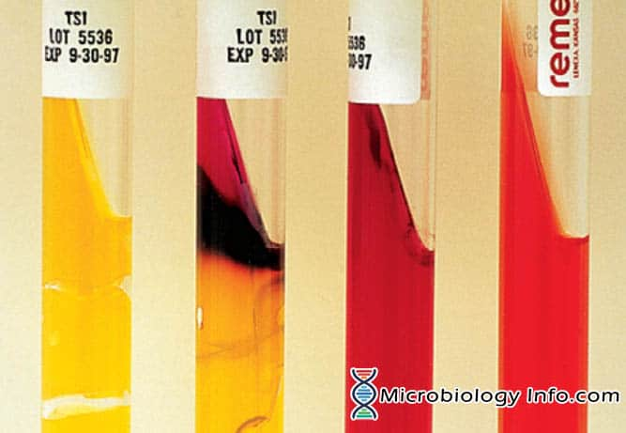
TSIA:
This test is challenging to interpret with only a positive/negative choice since there are many nuances. The positive negative scheme can work with TSI H2S (+/-), and TSI gas (+/-) as shown in the table list
https://microbiologyinfo.com/triple-sugar-iron-tsi-test/
Negative gas
No acid
No H₂S
positive gas
Acid positive
positive H₂S

Slide 7
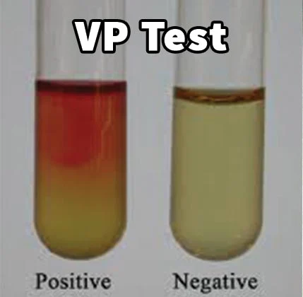
MR Test VP test Indole test Citrate test
Negative gas
No acid
positive gas
Acid positive
negative
positive

